Slide 1
Cut chart paper control
☆Electronic chart system
Quick check for …
・Abnormal condition of inside temp.
・ History of inside temp.
・ Latest one-week temp/alarm history.
WITHOUT partlow temperature recorder

Slide 2
Cut chart paper control
☆Electronic chart system
Quick check for …
・Abnormal condition of inside temp.
・ History of inside temp.
・ Latest one-week temp/alarm history.

Slide 3
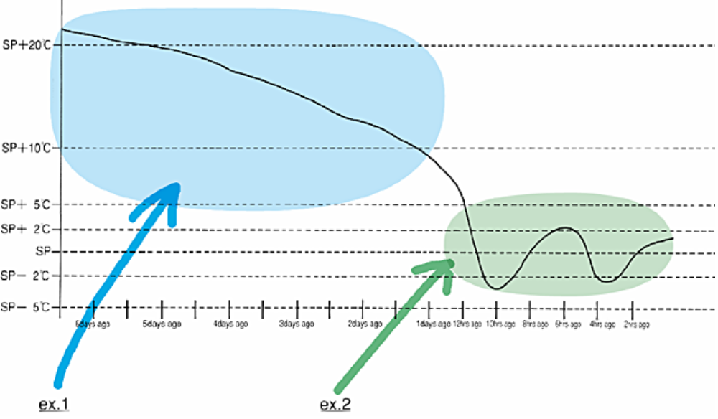
Technical features
■Controller（DECOSⅢc）
☆Electronic chart system
・Graphics of inside temp.（2）

Slide 4
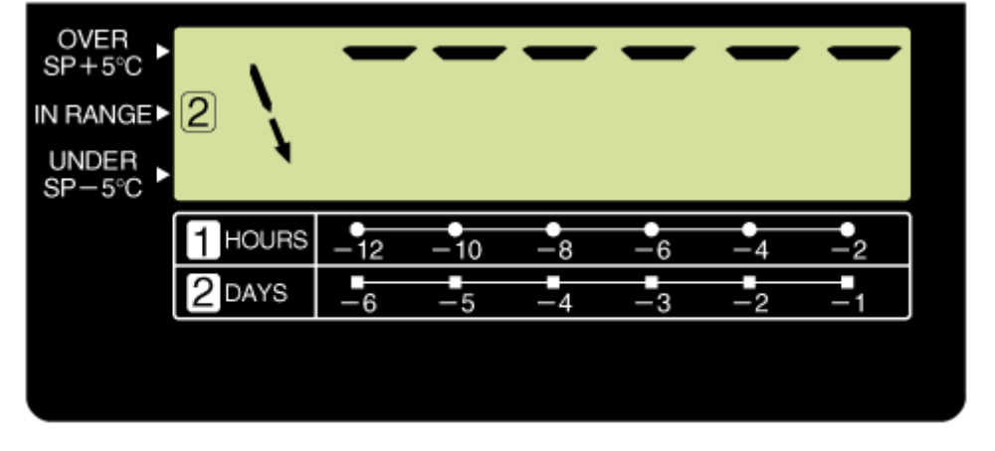
Technical features
■Controller（DECOSⅢc）
☆Electronic chart system
・Graphics of inside temp.（2）
ex.1
＜7 days＞

Slide 5
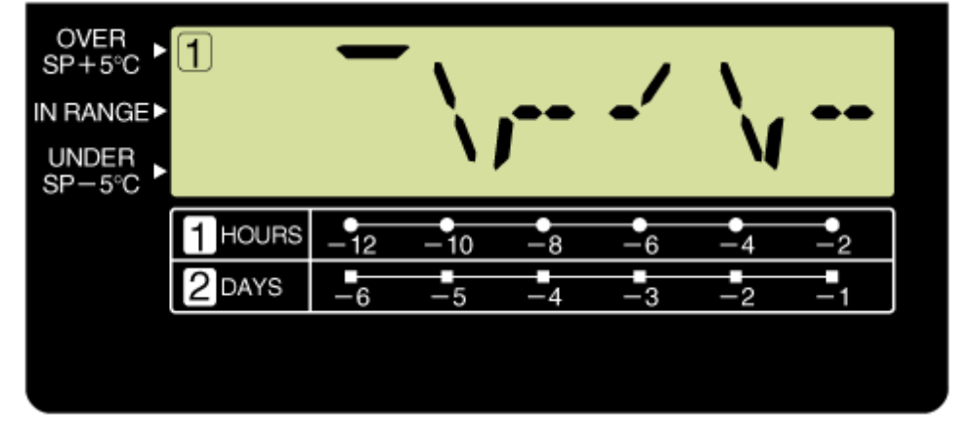
Technical features
■Controller（DECOSⅢc）
☆Electronic chart system
・Graphics of inside temp.（2）
ex.2
＜12 hours＞

Slide 6
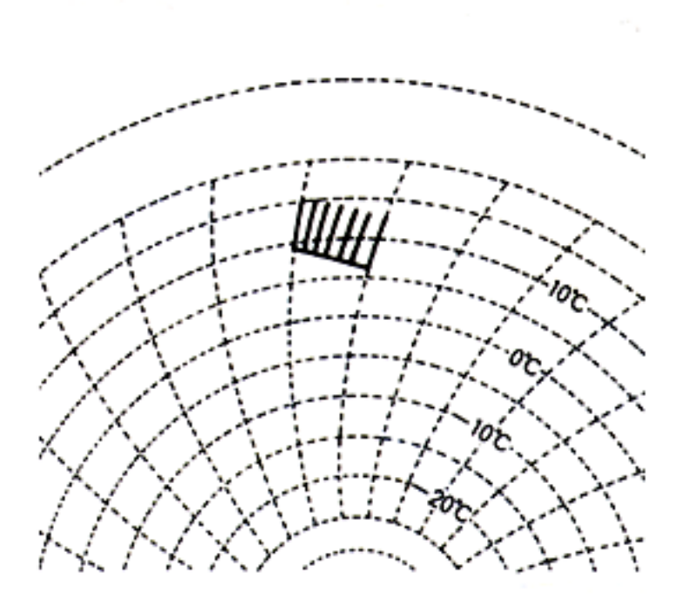
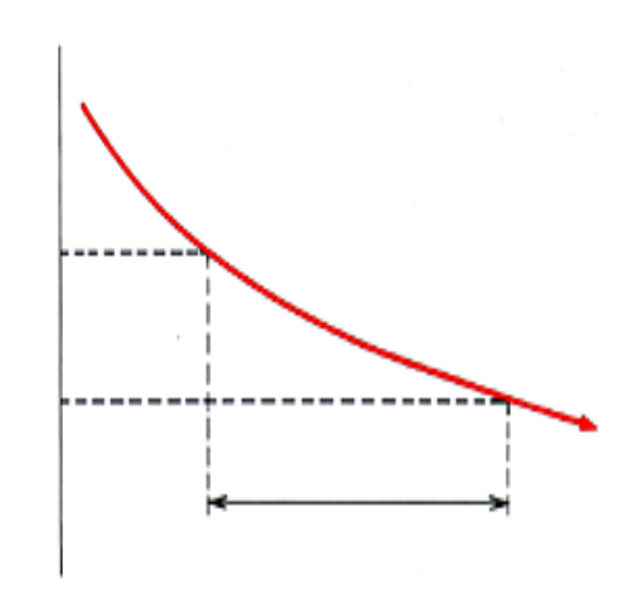
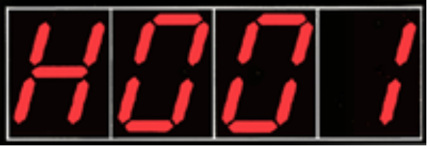
Technical features
■Controller（DECOSⅢc）
☆Electronic chart system
・Abnormal condition of inside temp.
Temp
Less
than
3℃
4hours

Slide 7
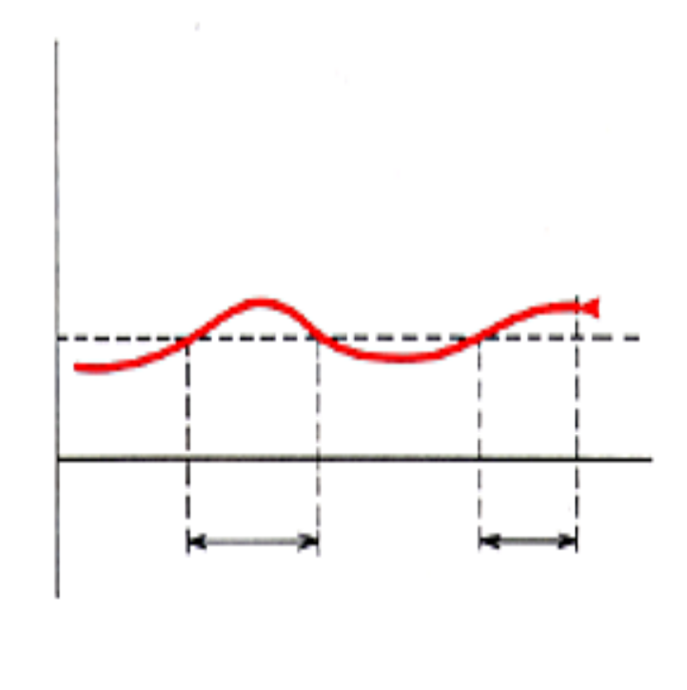
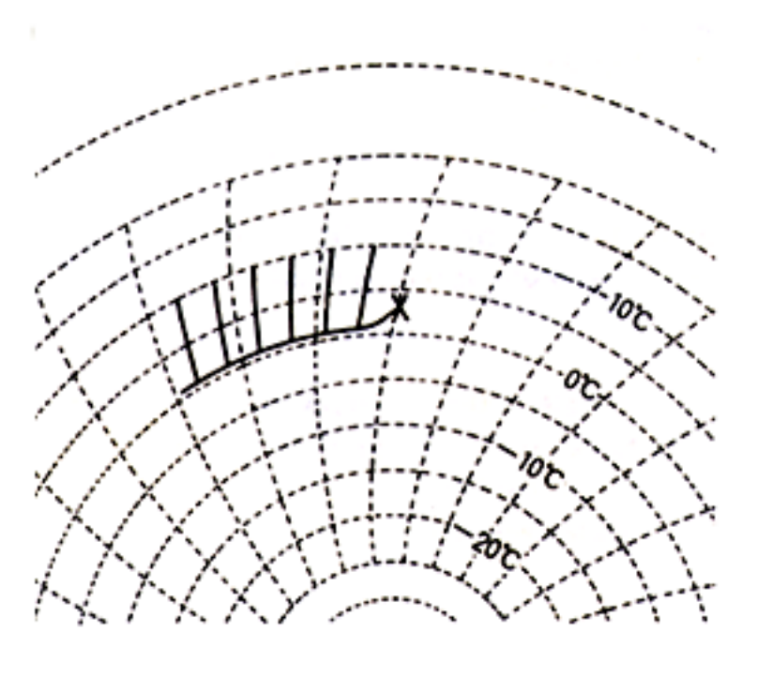
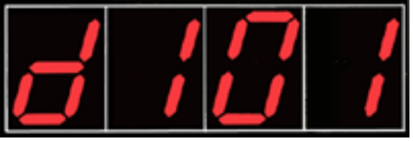
Technical features
■Controller（DECOSⅢc）
☆Electronic chart system
・History of inside temp.（1）
＜Code indication＞
Temp
S.P.+1℃
S.P.
Total 1 hour

Slide 8
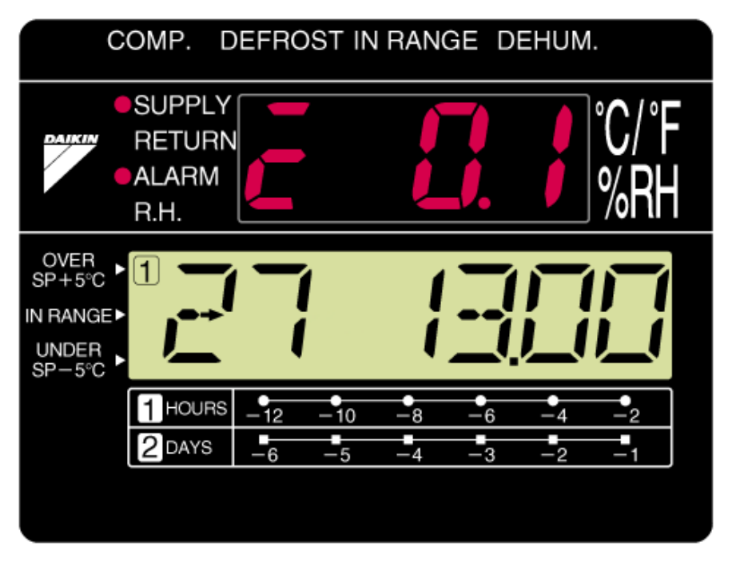
Technical features
■Controller（DECOSⅢc）
☆Electronic chart system
・Controlled temp.（The other temp.）for Max last 7 days.

Slide 9
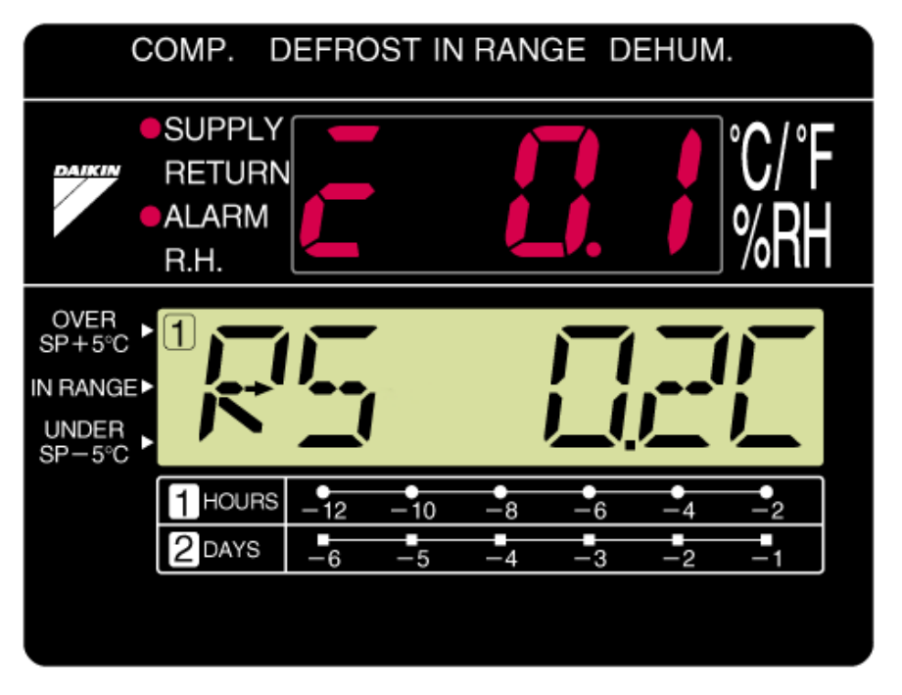
Technical features
■Controller（DECOSⅢc）
☆Electronic chart system
・Controlled temp.（The other temp.）for Max last 7 days.
after one second

Slide 10
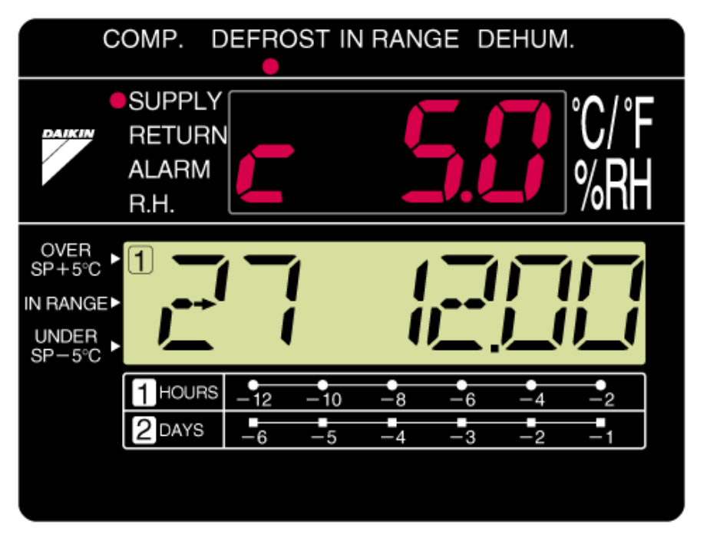
Technical features
■Controller（DECOSⅢc）
☆Electronic chart system
・Controlled temp.（The other temp.）for Max last 7 days.
after one second

Slide 11
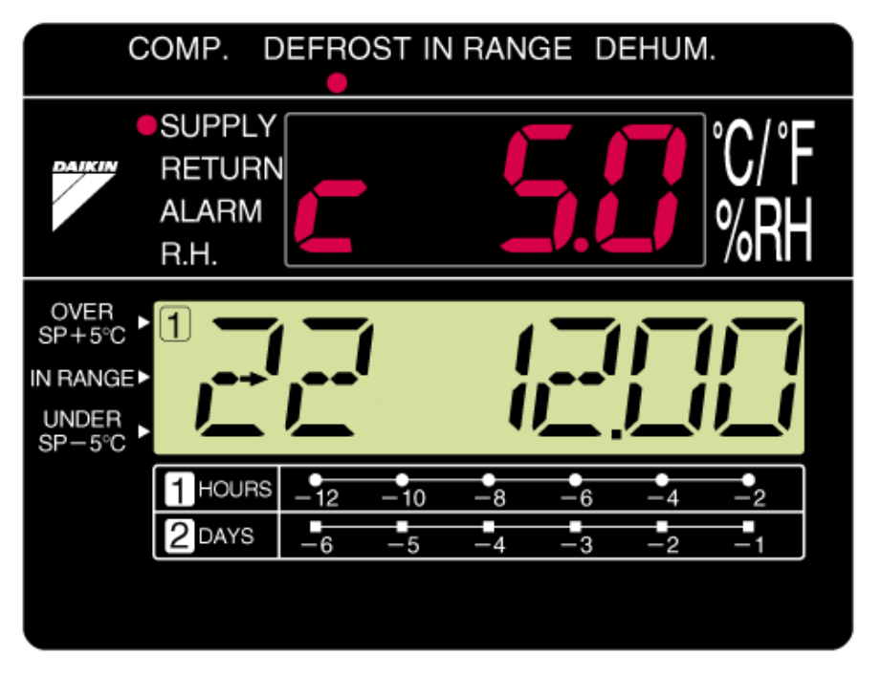
Technical features
■Controller（DECOSⅢc）
☆Electronic chart system
・Controlled temp.（The other temp.）for Max last 7 days.
after several seconds

Slide 12
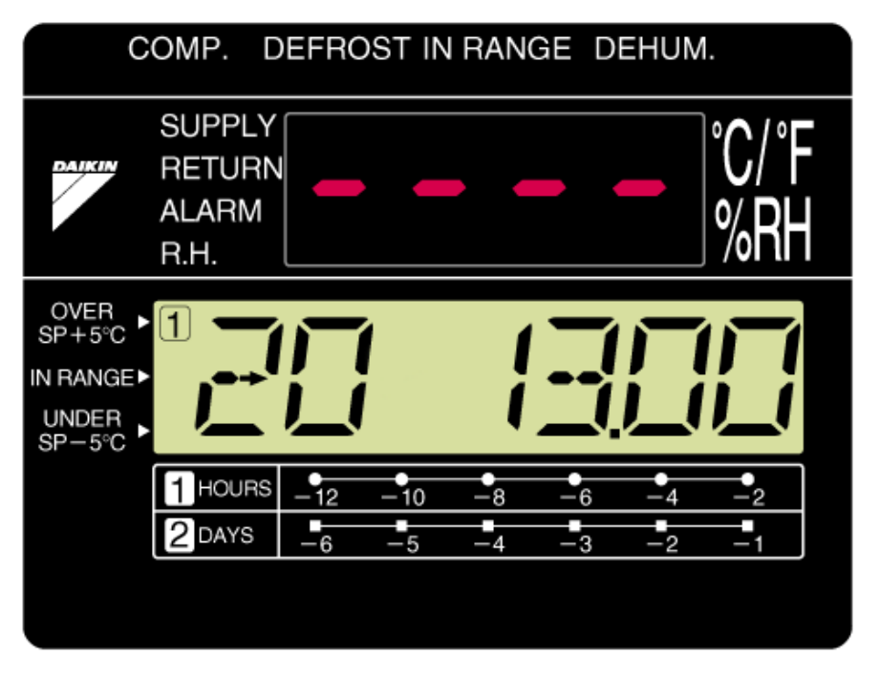
Technical features
■Controller（DECOSⅢc）
☆Electronic chart system
・Controlled temp.（The other temp.）for Max last 7 days.
final display

Slide 13
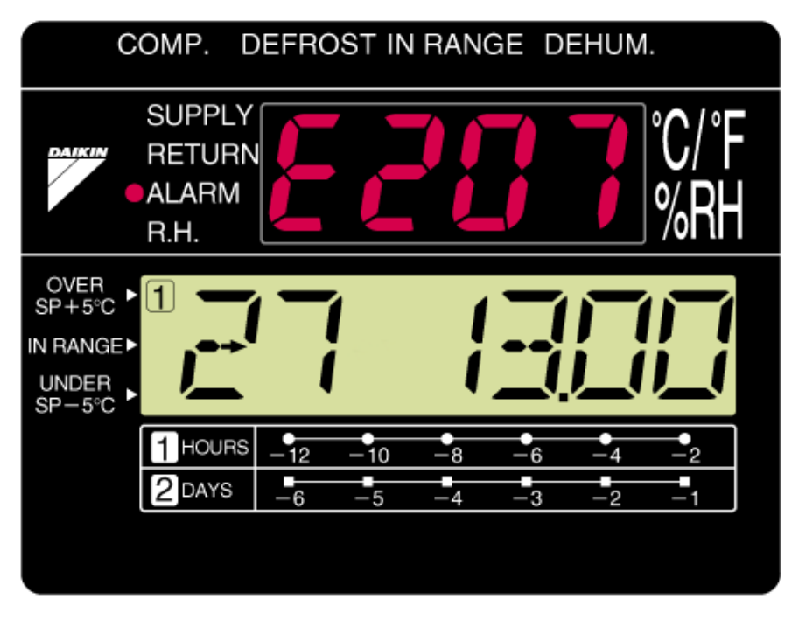
Technical features
■Controller（DECOSⅢc）
☆Electronic chart system
・Alarm record for Max. last 7 days

Slide 14

Technical features
■Controller（DECOSⅢc）
☆Electronic chart system
・Alarm record for Max. last 7 days
after one second

Slide 15
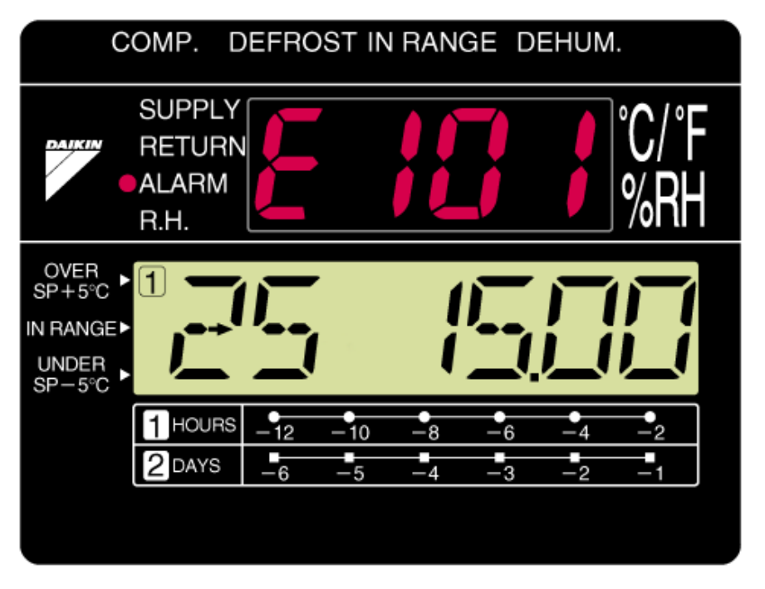
Technical features
■Controller（DECOSⅢc）
☆Electronic chart system
・Alarm record for Max. last 7 days
after one second

Slide 16

Technical features
■Controller（DECOSⅢc）
☆Electronic chart system
・Alarm record for Max. last 7 days
final display

